Slide 1
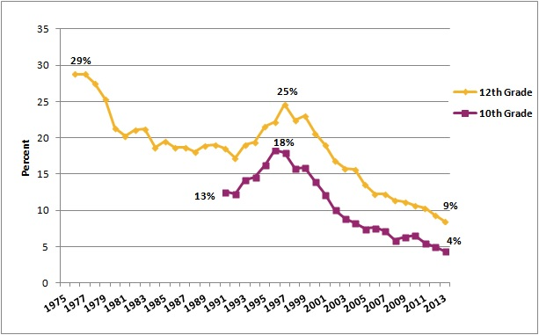
30 Day Prevalence of Daily Use of Cigarettes, by Grade, 1975-2013
Notes:
Good news: smoking is WAY DOWN. Bad news: E cigs are WAY UP!!!!

Slide 3
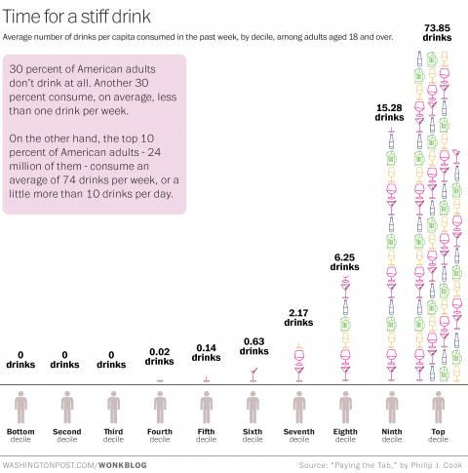
Think you drink a lot? This chart will tell you…

Slide 4
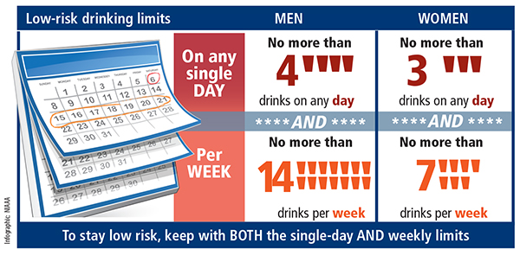
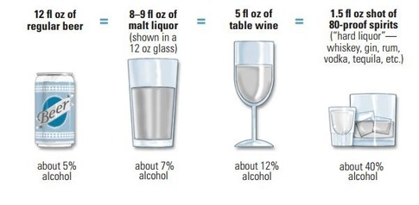

Slide 6
Adverse Childhood Experiences
Emotional Neglect
Abuse
Household Dysfunction
Adverse
childhood
experiences
Household
dysfunction
Emotional
neglect
Abuse

Slide 7
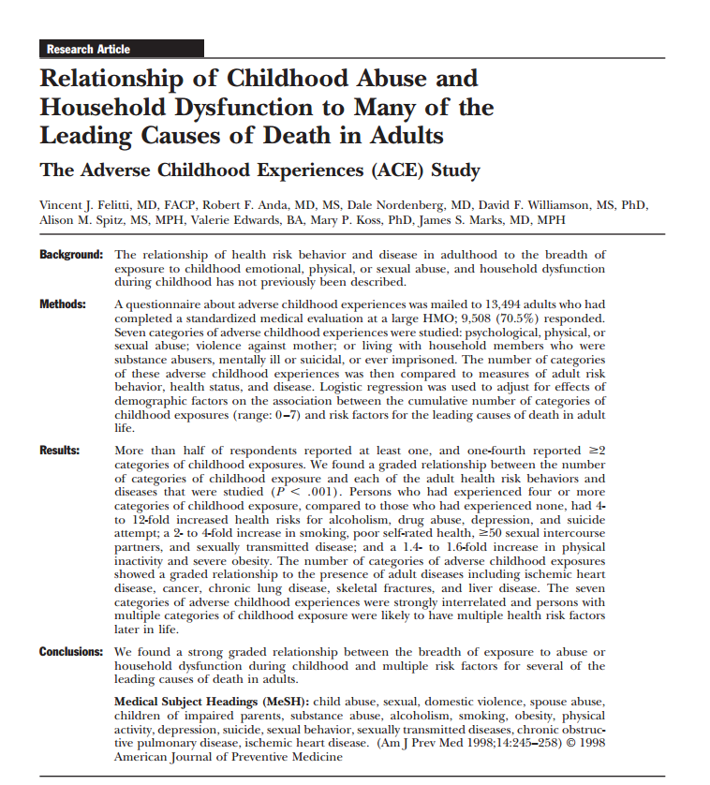

Slide 8
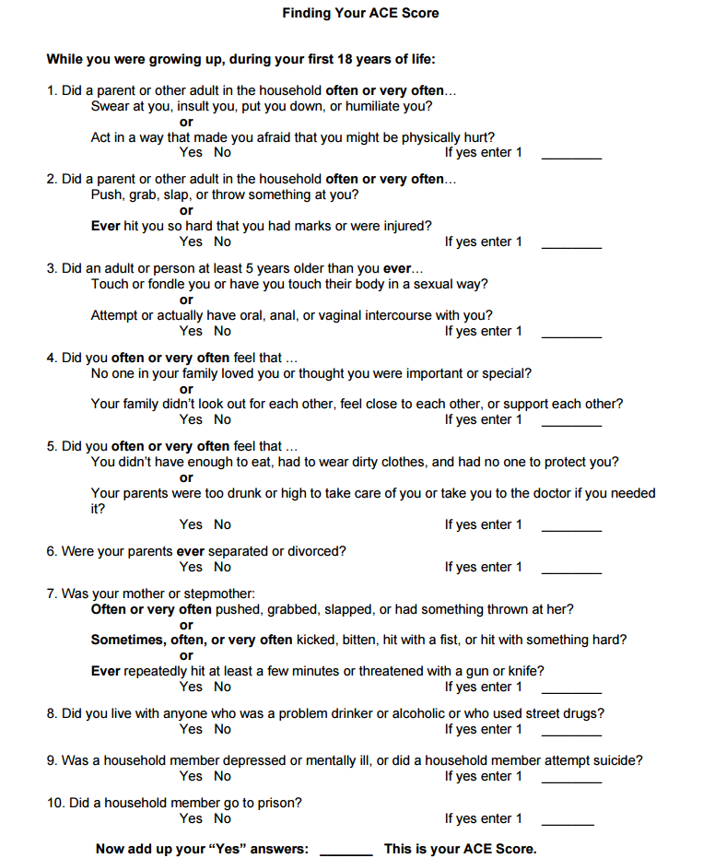

Slide 9
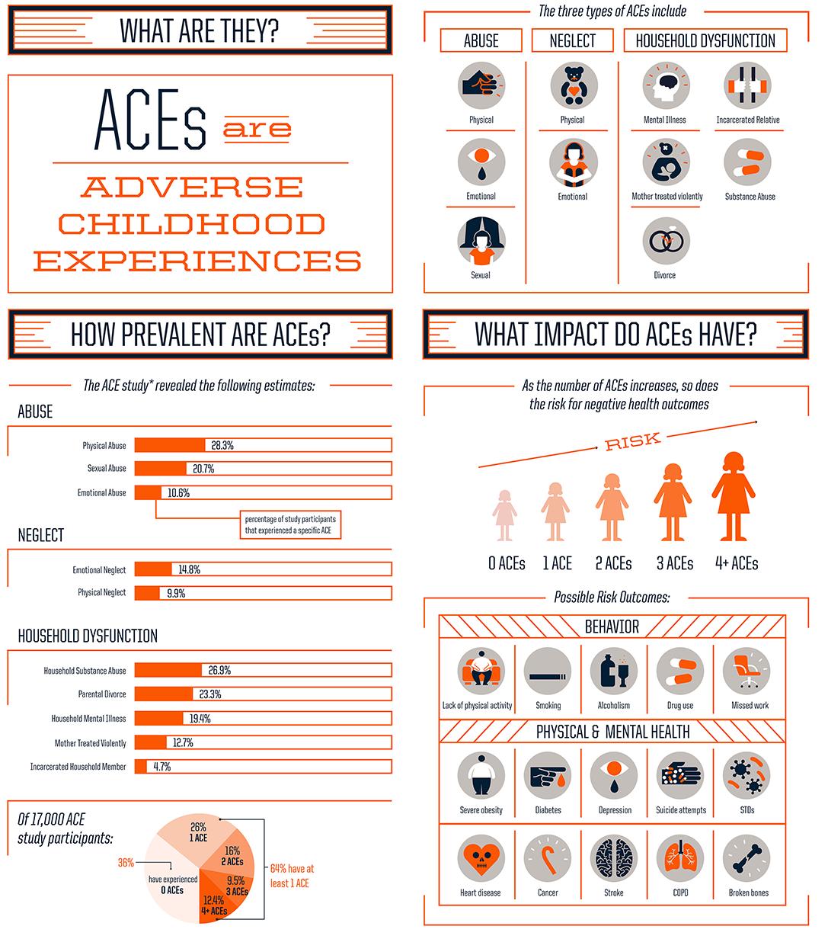
Notes:
If you were to screen all or your chronic pain pts, pts with addiction, and many other chronic diseases, I think you would find very high ACE scores. The body under threat – full sympathetic response, pealing warning bells – those are the pathways that we need to quiet. We should not just fill opioid receptors in the brain.
We are going to come back to this. I worry that I am all no opioids when I speak. I am not. I want us to recognize that 20% - 30% of your pts on chronic opioids have developed an addiciton to those drugs and let’s address that disease.

Slide 10
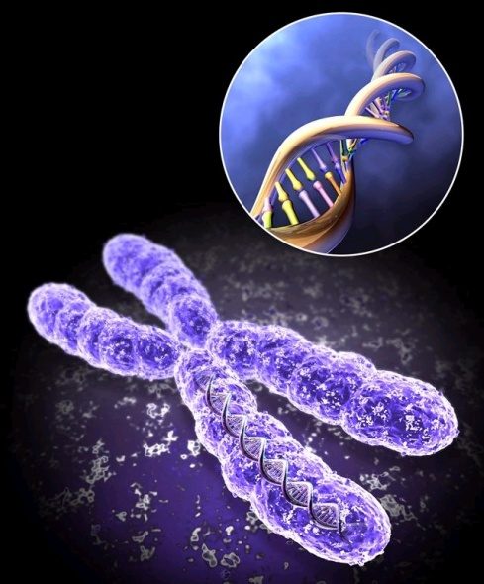
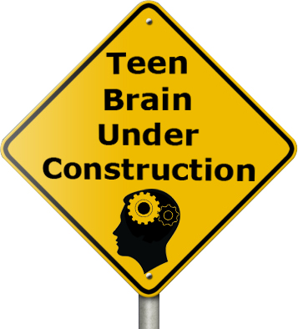
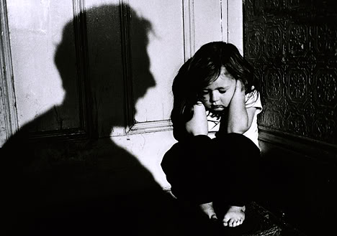
Talk Early, Talk Often “Delay, Delay, Delay or Avoid Altogether”
Genetics
Trauma
Early Use

Slide 11
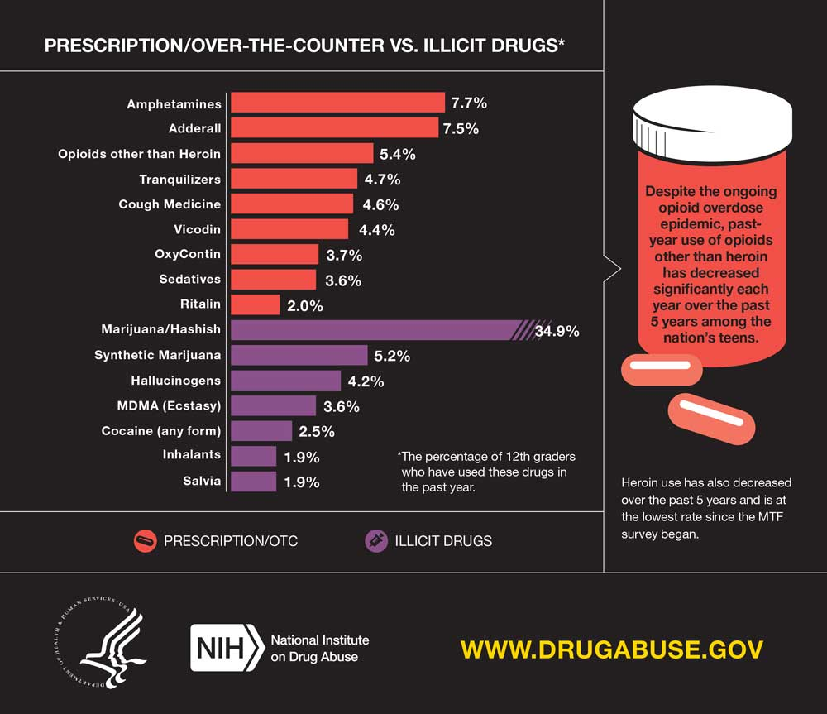

Slide 12
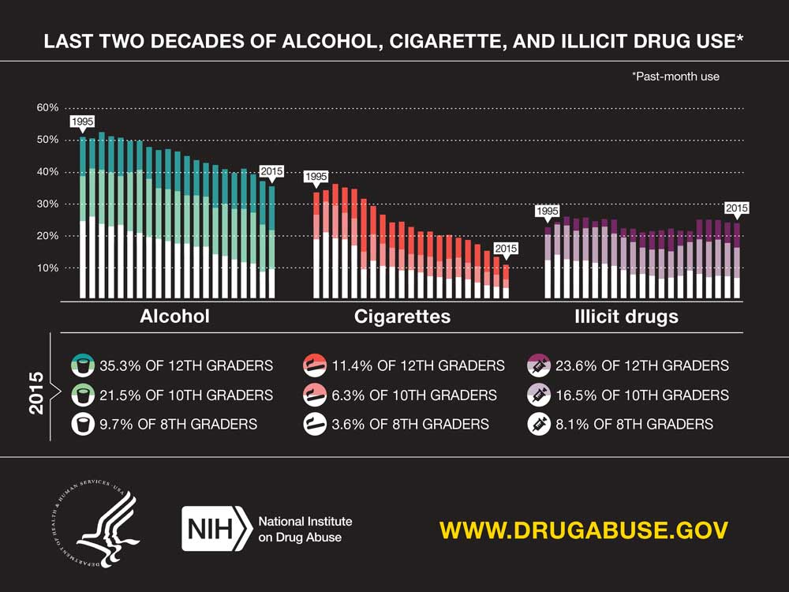

Slide 13
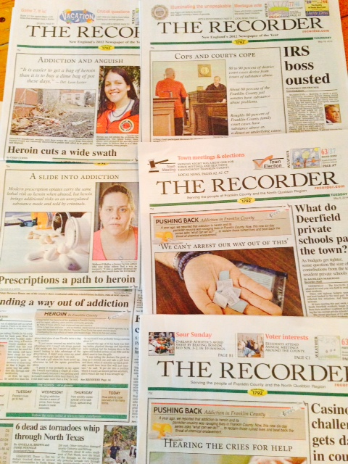

Slide 14
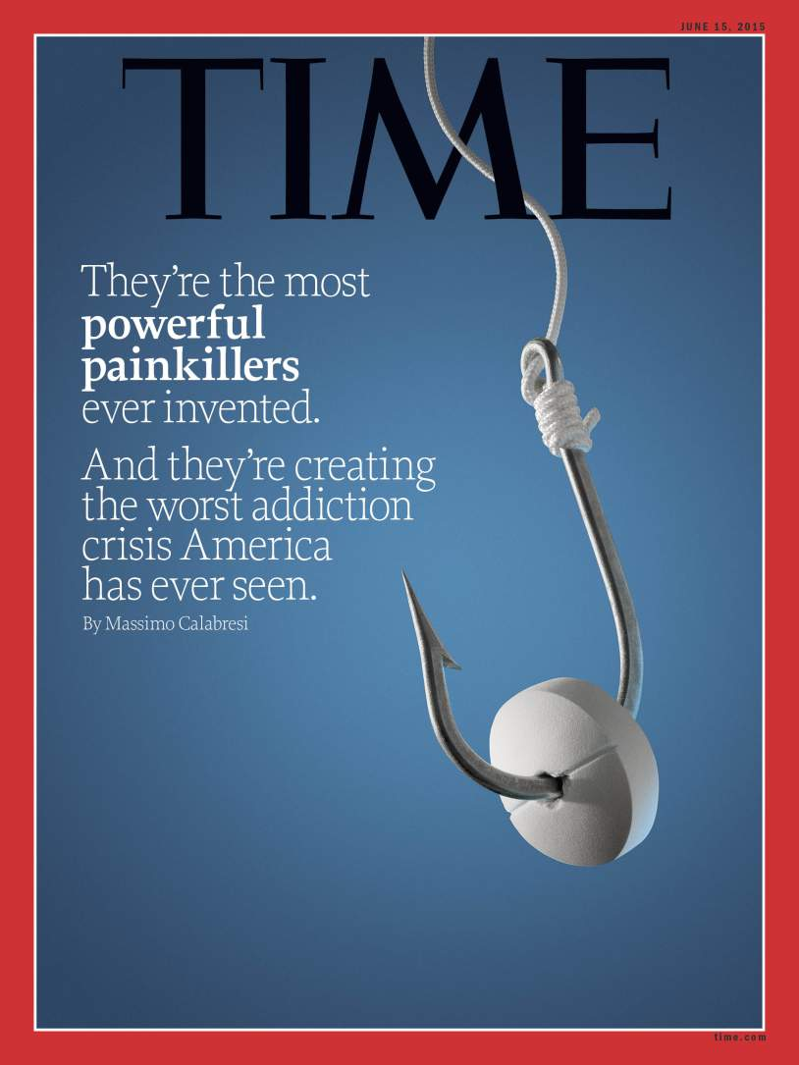

Slide 15
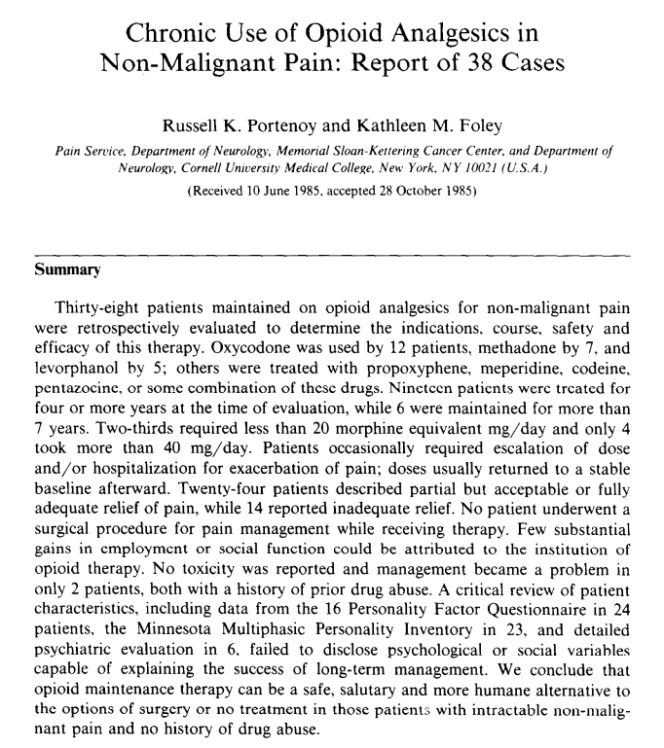
Notes:
In 1986 a paper describing the treatment of 38 chronic pain patients concluded that OPRs could be prescribed safely on a long-term basis (61). Despite its low-quality evidence, the paper was widely cited to support expanded use of opioids for chronic non-cancer pain. Opioid use increased gradually in the 1980s. In 1996, the rate of opioid use began accelerating rapidly (38). This acceleration was fueled in large part by the introduction in 1995 of OxyContin, an extended release formulation of oxycodone manufactured by Purdue Pharma.
Between 1996 and 2002, Purdue Pharma funded more than 20,000 pain-related educational programs through direct sponsorship or financial grants and launched a multifaceted campaign to encourage long-term use of OPRs for chronic non-cancer pain (86). As part of this campaign, Purdue provided financial support to the American Pain Society, the American Academy of Pain Medicine, the Federation of State Medical Boards, the Joint Commission, pain patient groups, and other organizations (27). In turn, these groups all advocated for more aggressive identification and treatment of pain, especially use of OPRs.

Slide 18
Notes:
Do you remember the maps that used to show obesity in the US?

Slide 19
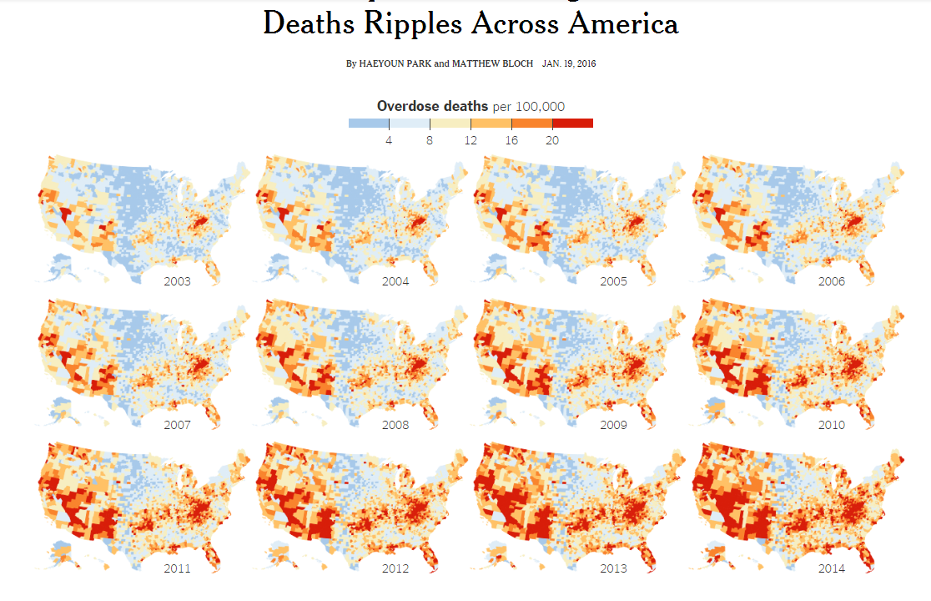
NYT January 19, 2016

Slide 20
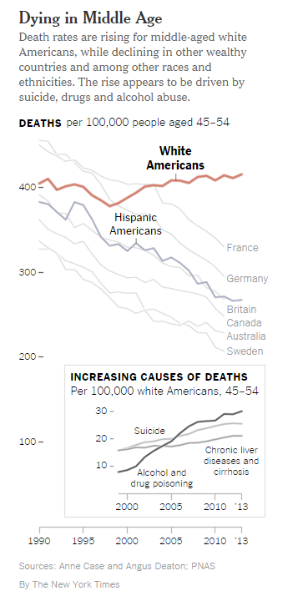

Slide 22
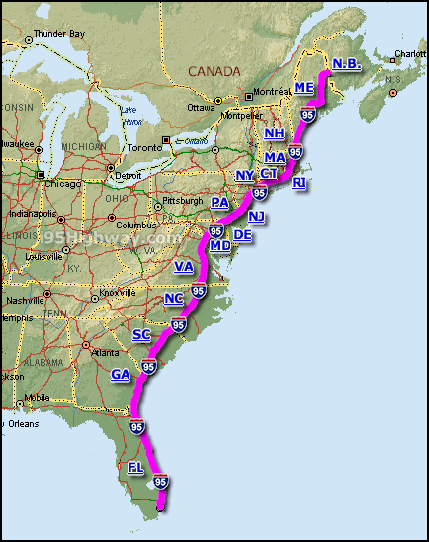
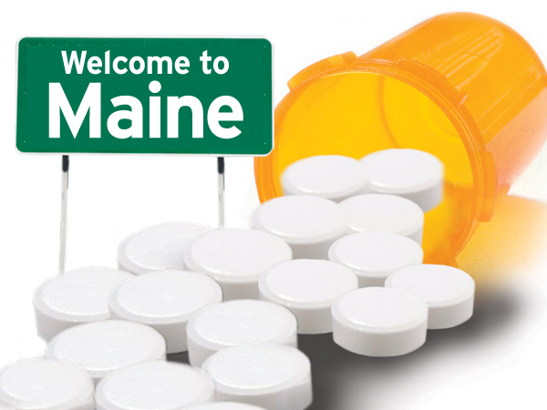
Notes:
Since 1996 or so, we have been prescribing opiates with a heavy hand. Some of us have been more indescriminate than others. Think about how much you were being told you should prescribe in the 1990s. My father was a primary care doctor in Palmer for 27 years – he can count on one hand the number of times he wrote a prescription for opiates.

Slide 23
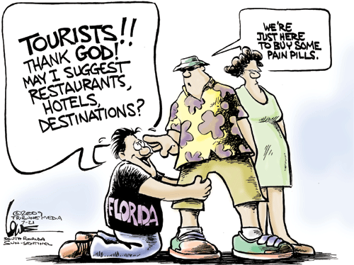

Slide 24
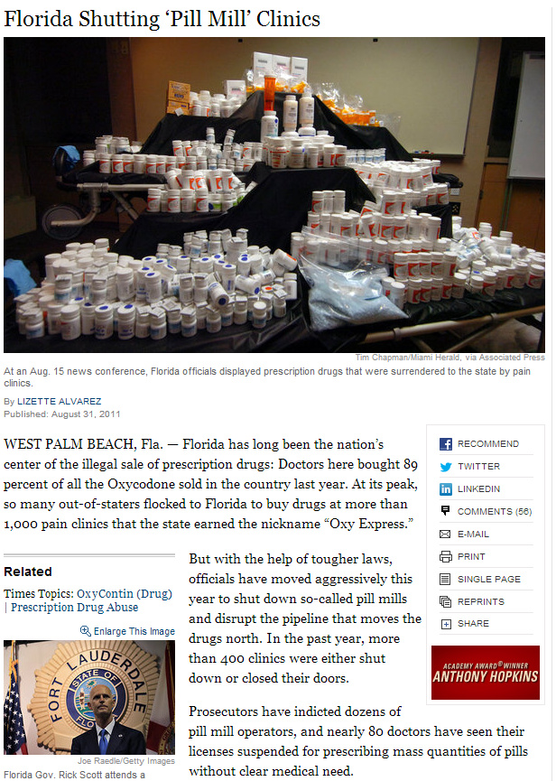
http://www.nytimes.com/2011/09/01/us/01drugs.html?src=me&ref=us

Slide 25
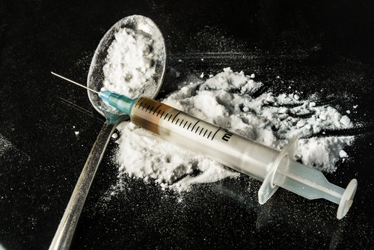

Slide 26
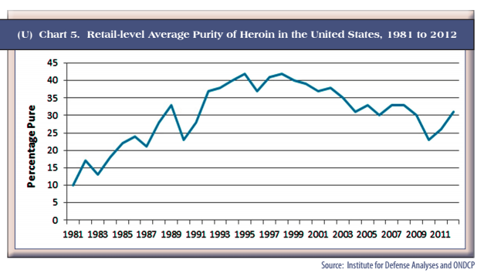
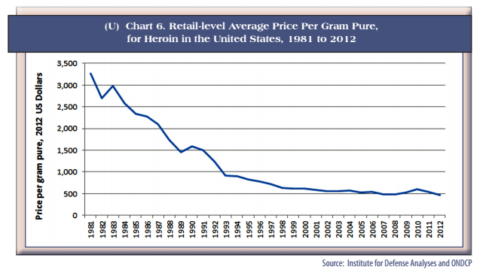

Slide 27
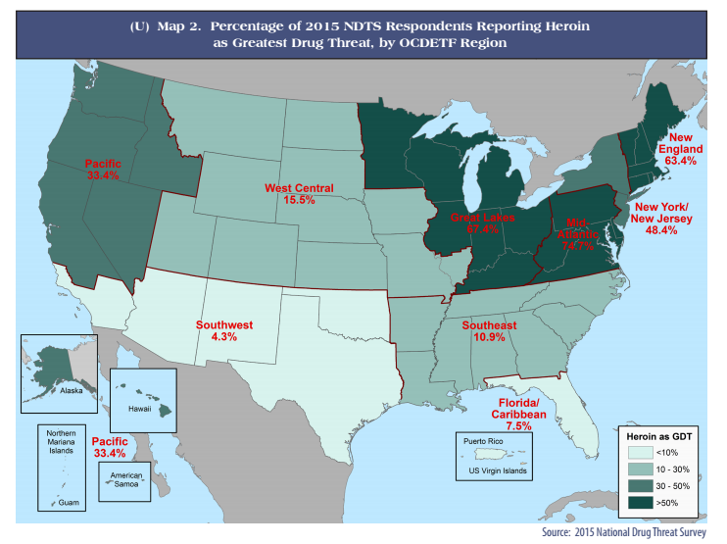

Slide 28
Notes:
Massachusetts is not alone in our problems. I think it easy to feel as though Franklin County is the center of the opioid epidemic. It is not. There are many states that are much worse.

Slide 29
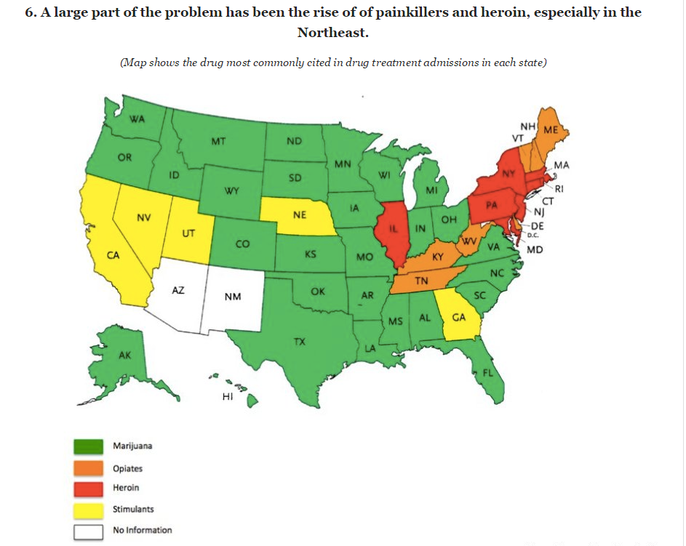
Notes:
This is the heroin map now. Imagine Appalachia and the Entire South filled in. Imagine what our rates of Hep C and HIV will be then. Imagine what the death rate will be then. We need to be training people now to recognize and treat addiction in advance of the rug getting pulled out from under people. There is no human benefit in pulling away people’s prescriptions and having them turn to Heroin.

Slide 30
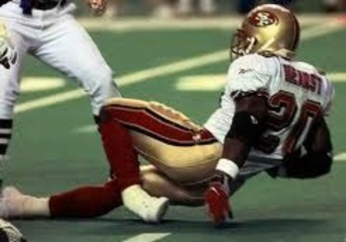
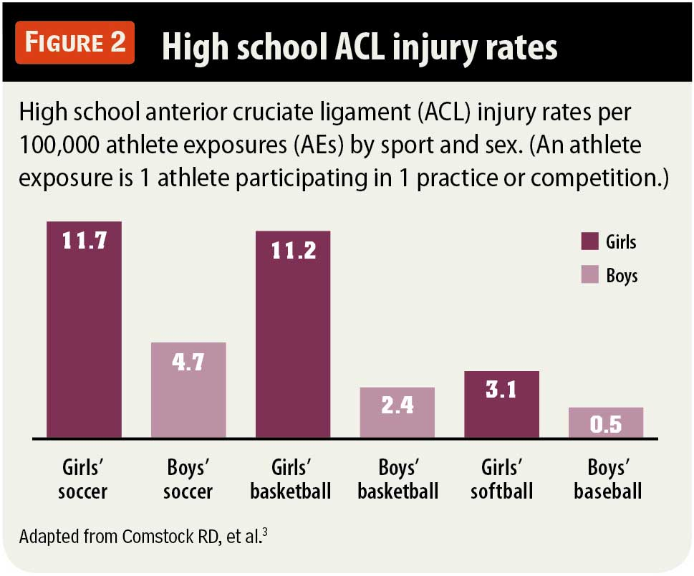
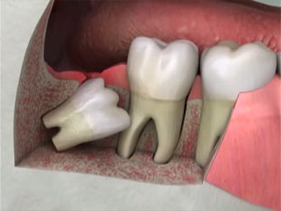

Slide 31
Signs at Home
More time spent away from home
Frequent, secret phone calls
Trouble with the police
Missing money, credit cards, and/or valuables
Pawn slips
Purchases returned for refunds
Small plastic Ziploc bags
Bottles of vinegar and bleach and cotton balls
Aluminum foil or chewing gum wrappers with burn marks
Spoons with burn marks or missing spoons

Slide 32
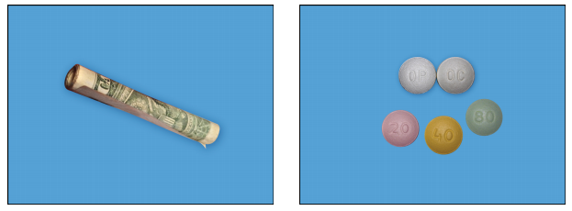
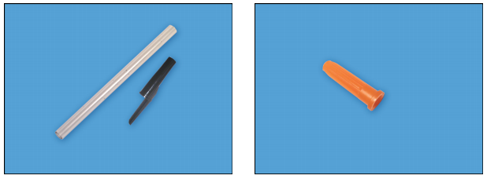
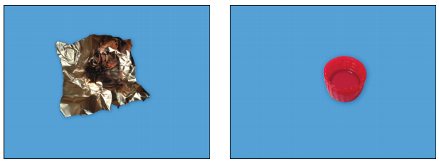
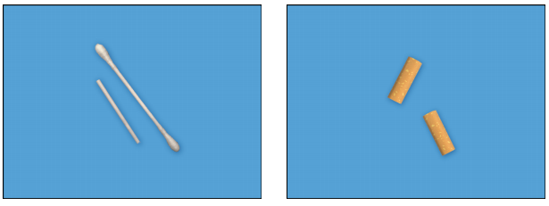
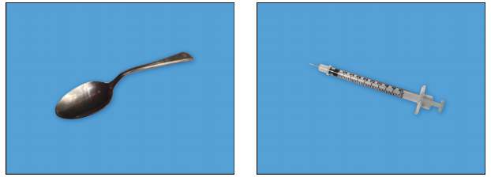
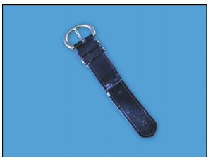

Slide 33
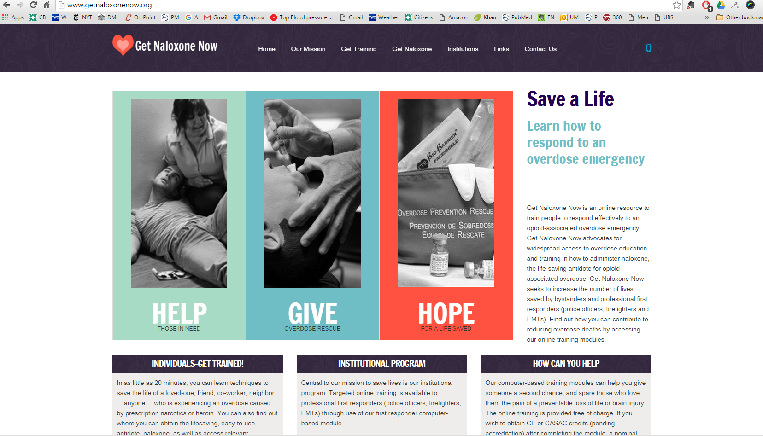
Notes:
Get Naloxone Now 59.5

Slide 34
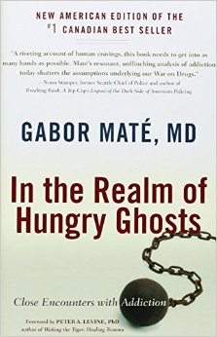
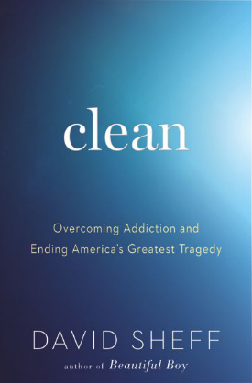
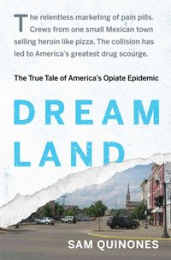

Slide 36
